Slide 1
CrisprVi: a software for visualizing and analyzing CRISPR sequences of prokaryotes
John Wesley Mathis
ECE/SSE 591

Slide 2
What is CRISPR?
Clustered Regularly Interspaced Short Palindromic Repeats
Natural defense mechanism in bacterial immune system
CRISPR regions contain short, repetitive DNA sequences interspaced with unique sequences called spacers
CRISPR is used to store genetic info from past viral infection and recognize and destroy invading viruses in subsequent encounters

Slide 3
What is Cas?
CRISPR-Cas System
Clustered Regularly Interspaced Short Palindromic Repeats-CRISPR-associated
Powerful gene editing tool to make precise changes in DNA of living organisms
Essential for bacterial adaptive immunity

Slide 4
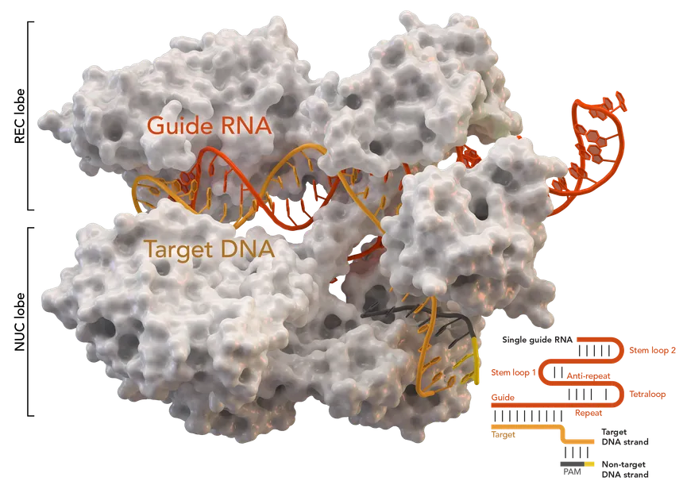
Notes:
Cas9: type of CRISPR-associated protein
Acts as a molecular scissor, capable of cutting DNA at a specific location
Adapted as a genome editing tool
Can be programmed with a small RNA molecule to guide it to the specific DNA sequence, where it cuts the DNA

Slide 5
The Problem with CRISPR Visualization and Analysis
Comprehensive Tools
Investigate loci and sequences of DRs and spacers
Existing tools: CRT, PILER-CR, CRISPRFinder, etc.
Limitations of Current Tools:
Lack interactive and user-friendly visualization
Complexity and non-interactivity of Excel macros
Over-reliance on specific detection tools
Confusing visual outputs with complex datasets
Gap in the market
Need for an all-in-one tool to visualize, manipulate, and analyze CRISPR arrays effectively
Notes:
Tools, such as CrisprStudio, help to provide clear and intuitive visualizations of CRISPR sequences, making it easier for researchers to interpret complex genetic data.

Slide 6

Why use Python?
Extensive Bioinformatics libraries
Biopython: sequence analysis and data manipulation
Pandas: efficient data handling and analysis
Matplotlib & Seaborn: powerful data visualization tools
Seamless integration with existing bioinformatics tools
Large, active community
Capable of handling large datasets efficiently

Slide 7





Python Libraries Used
Biopython: sequence analysis and manipulation
Pandas: efficient data organization and management
NumPy: handling large datasets
Matplotlib: creating visuals
Seaborn: high-level statistical graphics
Notes:
Implemented pandas and numpy for data processing and computation
While the matplotlib and seaborn packages are used to visualize results.

Slide 8
CrisprVi Results
Python package with GUI
Flexible: allows user to choose CRISPR detection
Notes:
The researchers were able to successfully develop a python package with a GUI
CrisprVi is a flexible package that allows various CRISPR finding methods such as CRISPRCasFinder, MinCED, and others. This allows the user to use any CRISPR finding method and even use multiple methods to compare the prediciton accuracy between the tools.

Slide 9
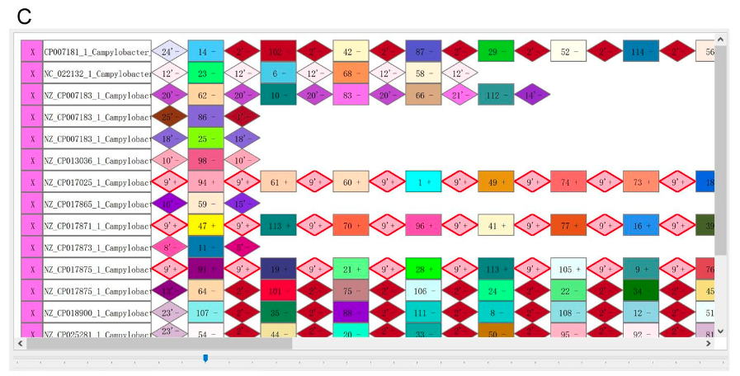
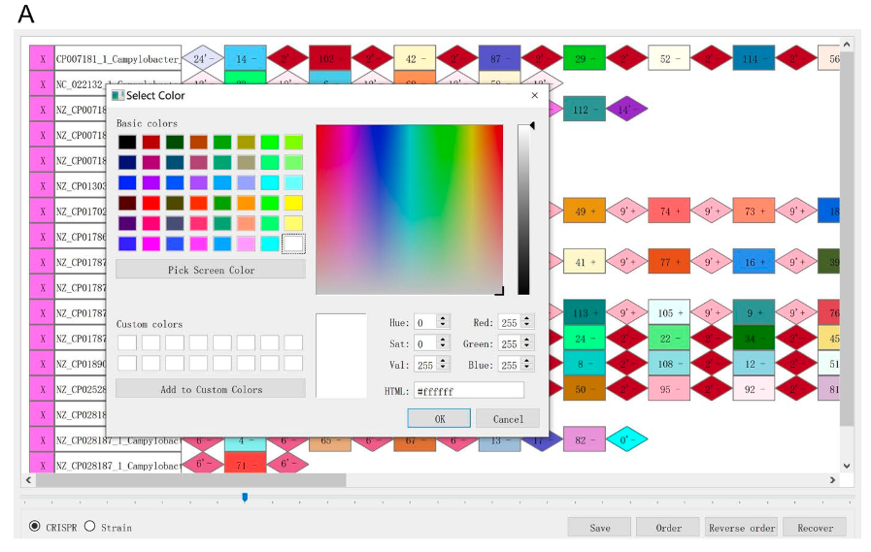
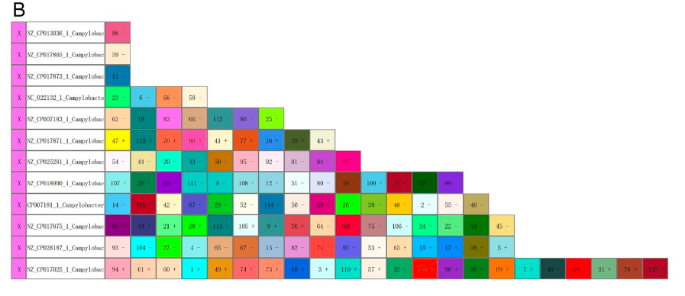
User can customize graphics for DRs/spacers
Notes:
User is able to change graphic color manually, sort spacer arrays by length and even highlight identical CRISPRs by red borders.
Visualized CRISPRs of 12 C. Coli strains which where predicted by CRISPRCasFinder

Slide 10
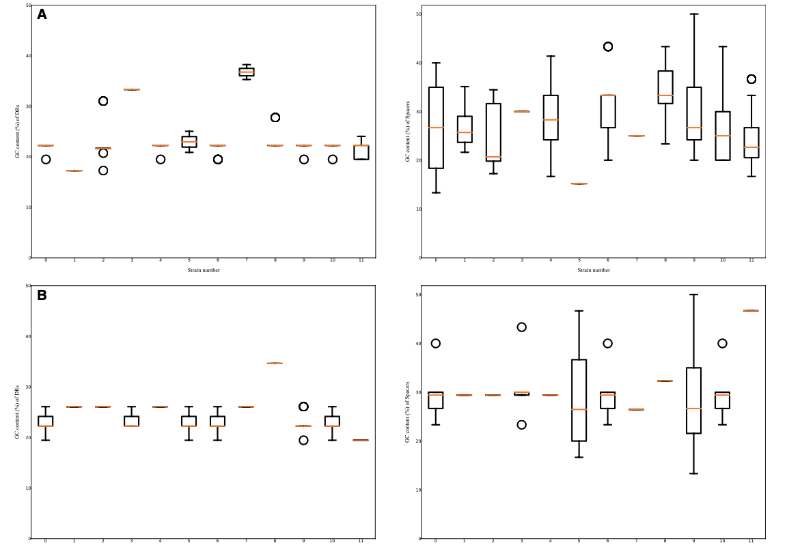
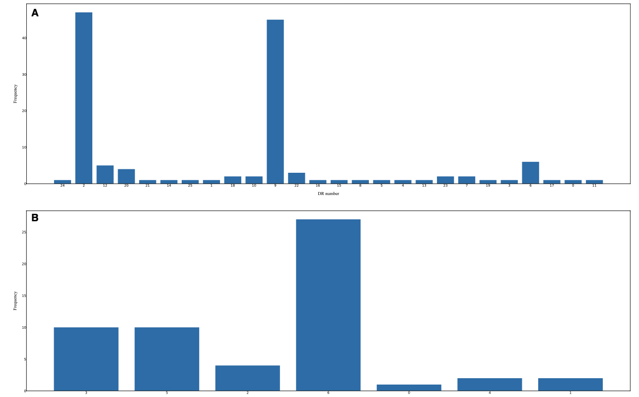
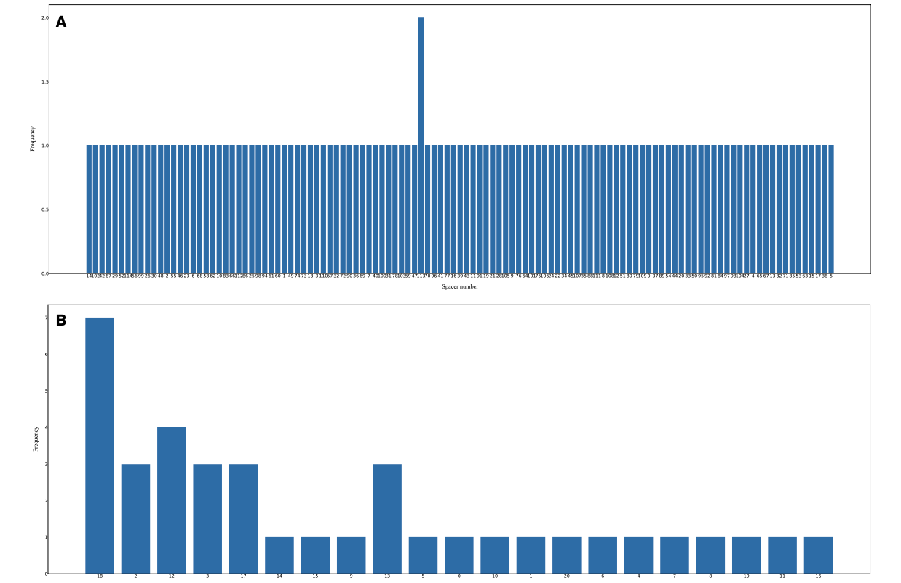
Perform statistical analysis of the DRs/spacers on selected strains
Notes:
DRs occurred can be counted and displayed in histograms
Spacer counts across strains can be calculated and visualized in histograms
Users can inspect details of the plots using commands in the menu.

Slide 11
My Thoughts
Address a gap in bioinformatics tools
Using Python ensures it is user-friendly
Contributes to advancements in genetic research and biotechnology

Slide 12
References
Biopython. (n.d.). Biopython logo. Retrieved from https://biopython.org/wiki/logo
Jia, B., Zhang, X., Jiang, Q., Wang, Z., Zhang, Y., Hu, Y., & Wang, Y. (2022). CrisprVi: a software for visulaizing and analyzing CRISPR sequences of prokaryotes. BMC Bioinformatics, 23(1), 257. https://doi.org/10.1186/s12859-022-04716-9
Matplotlib developers. (n.d.). Matplotlib logo. Retrieved from https://matplotlib.org/stable/gallery/misc/logos2.html
NumPy developers. (n.d.). NumPy logo. Retrieved from https://github/com/numpy/numpy/tree/main/branding/logo
pandas development team. (n.d.). Pandas logo. Retrieved from https://pandas.pydata.org/about/citing.html
Python Software Foundation. (n.d.). Python logo. Retrieved from https://www.python.org/community/logos/
Seaborn developers. (n.d.). Seaborn logo. Retrieved from https://seaborn.pydata.org/citing.html
Splettstoesser, T. (n.d.). Cas9 protein structure [Image]. Wikimedia Commons. Retrieved from https://en.wikipedia.org/wiki/Cas9#/media/File:Cas9_5AXW.png

Slide 13
Questions?

